Slide 1
《英语国家社会与文化入门》(下册）
The Society and Culture
of Major English-Speaking Countries
An Introduction
(Book Two)

Slide 2
The United States of America Unit 14 Post-WWII American Foreign Policy

Slide 3
Quiz
Give the English and a brief explanation for the following:
冷战
美苏军备竞赛
杜鲁门主义
遏制政策
古巴导弹危机
朝鲜战争
单边主义
9/11恐怖袭击

Slide 4
Focal Points
the Beginning of the Cold War
the Arms Race
the Cuban Missile Crisis
the Korean War and the relations between the United States and China
the Containment Policy
Engagement and Expansion
Unilateralim
American Foreign Policy after September 11
the Bush Administration’s foreign policy
the Obama Administration’s foreign policy

Slide 5
The Unit Is Divided into Five Sections
I. The Beginning of the Cold War
II. The Arms Race
III. The Containment Policy
IV. Engagement and Expansion
V. American Foreign Policy after September 11

Slide 6
I. The Beginning of the Cold War
The United States emerged from WWII as a super power
as the sole possessor of atomic bombs;
as the wealthiest nation on earth;
as the most productive nation on earth;
as the leader of the “free world” and to dominate the post-war world order;
but with a head-on collision with the former Soviet Union, who resisted U.S. effort in this regard.

Slide 7
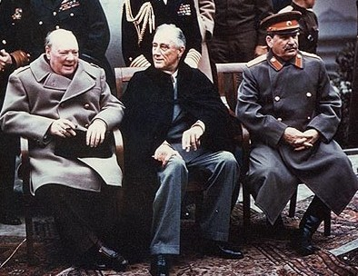
I. The Beginning of the Cold War
The United States emerged from WWII as a super power.

Slide 8
I. The Beginning of the Cold War
The Cold War as a Battle of Ideologies

Slide 9
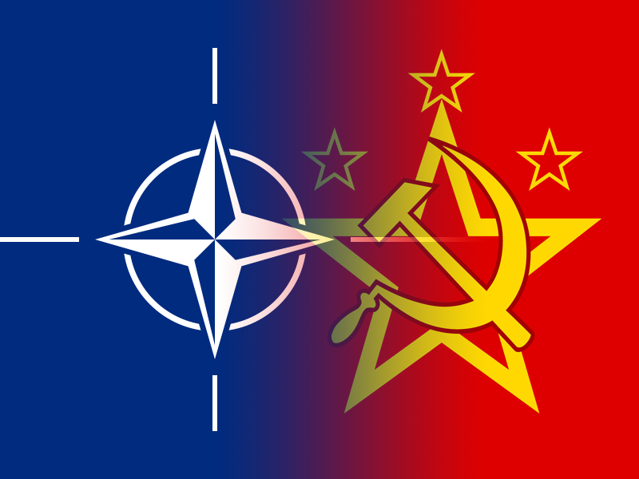
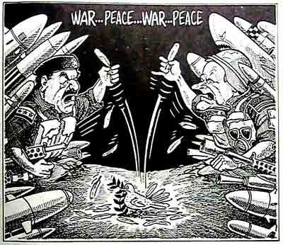
I. The Beginning of the Cold War
The North Atlantic Treaty Organization (NATO) in 1949 and the Warsaw Pact in 1955 split the world into two military blocs.

Slide 10
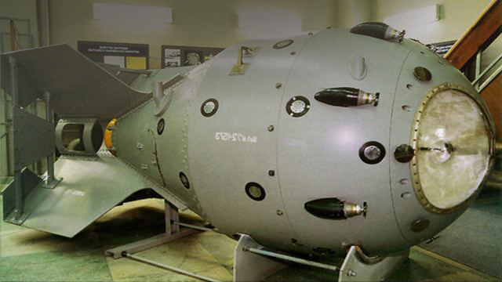
II. The Arms Race
In 1949, the Soviet Union exploded its first atomic bomb.
Soon, the United States tested its first hydrogen bomb in 1952, and the Soviet Union followed in 1953.

Slide 11
II. The Arms Race
In 1957, the Soviet Union launched two Sputniks into the orbit, demonstrating that they had the capability to carry the bombs to the United States. (Right: Sputnik 1)

Slide 12
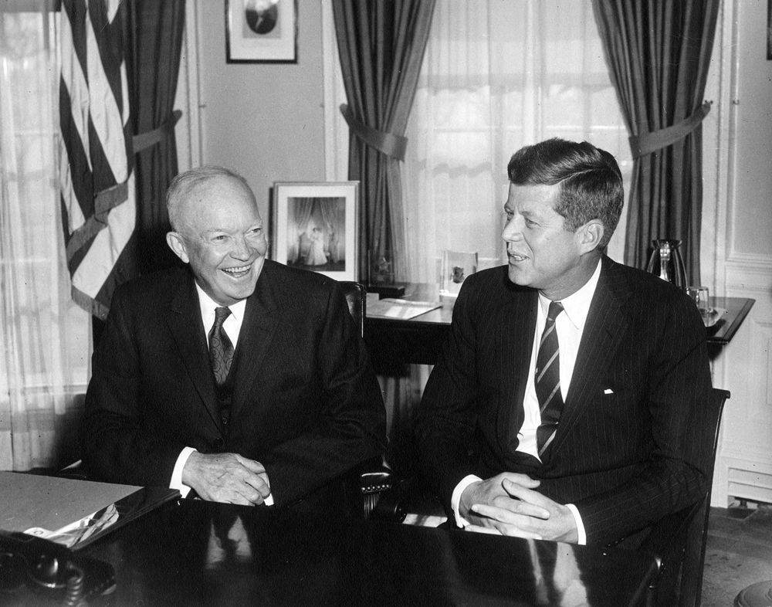
II. The Arms Race
The Eisenhower Administration and the Kennedy Administration stepped up nuclear weapons production.

Slide 13
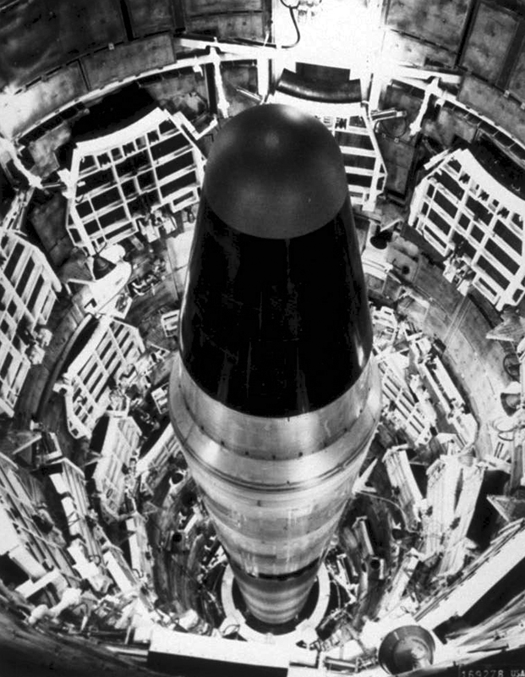
II. The Arms Race
By the 1980s, the Unites States and the Soviet Union had more than 50,000 nuclear weapons that could kill the people in the world many times.

Slide 14
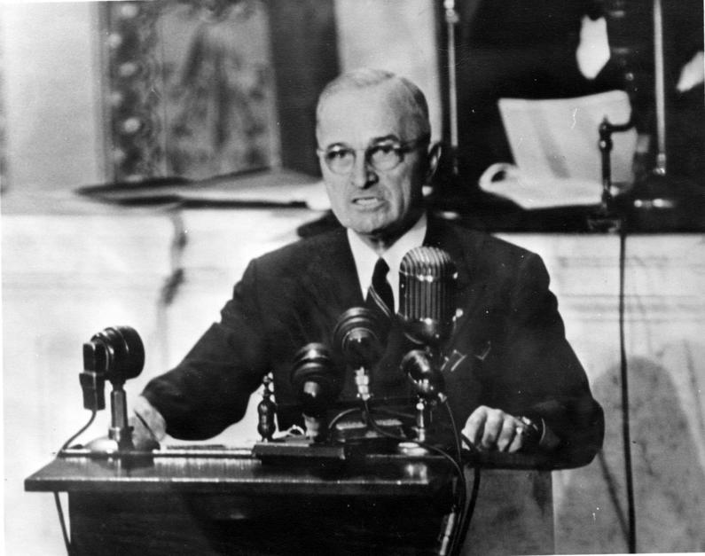
III. The Containment Policy
In 1948, President Truman put forward the Truman Doctrine which aimed to contain the former Soviet Union and communism in general.

Slide 15
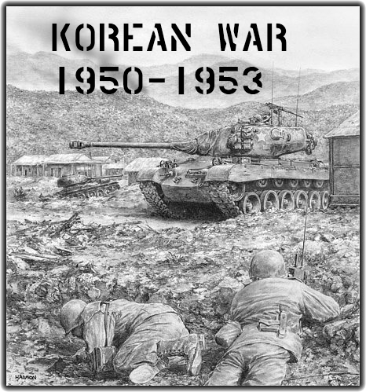
III. The Containment Policy
In order to contain communism, the United States fought two wars in Asia: the Korean War and the Vietnam War.

Slide 16
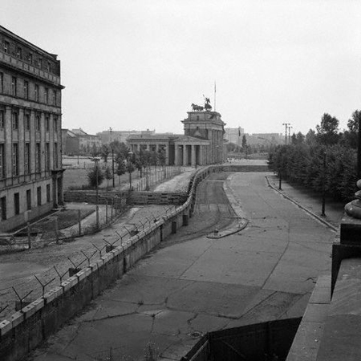
III. The Containment Policy
The crisis over Berlin in 1961 caused a large number of people to flee East Berlin and East Germany. In order to prevent the flow of talents, East German government began to build a concrete wall on August 13, 1961, separating East and West Berlin.

Slide 17
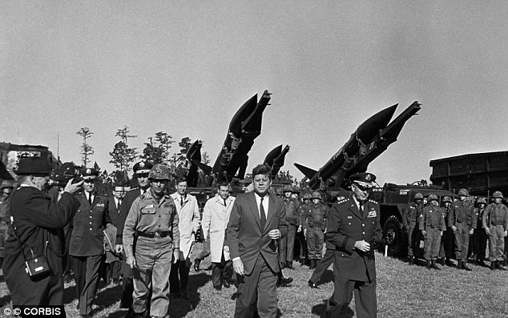
III. The Containment Policy
During the Cold War, the United States and the Soviet Union were on the brink of a nuclear war.
This occasion was the Cuban Missile Crisis in 1962 when, in 1959, Cuban leader Fidel Castro agreed to install Russian ballistic missiles in Cuba.

Slide 18
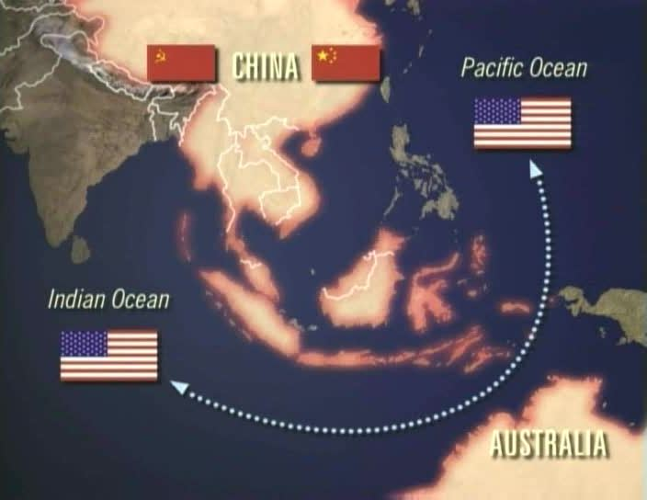
III. The Containment Policy
In Asia, the containment policy was directed against the People’s Republic of China.
The White Paper on China issued by the State Department in 1949 showed American hostility towards the new republic.

Slide 19
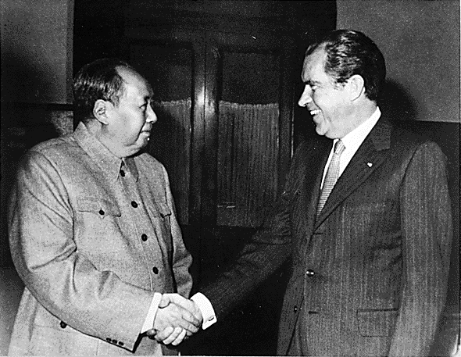
III. The Containment Policy
After President Nixon took over, he announced the Nixon Doctrine which stated that the United States would no longer fight the Cold War in Asia with Vietnam War being part of that war, and that Asian countries had to do the fighting themselves.
In 1972, Nixon made a trip to China for help to end the war in Vietnam.

Slide 20
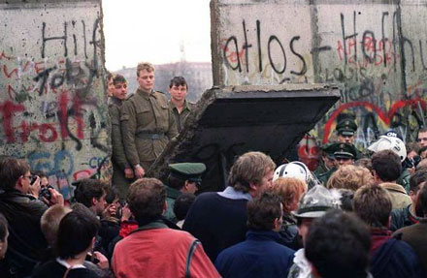
IV. Engagement and Expansion
The fall of the Berlin Wall in 1989, and regime changes in Eastern European countries and the disintegration of the Soviet Union at the end of 1991 radically changed the balance of power in the world.
The Cold War came to an end.

Slide 21
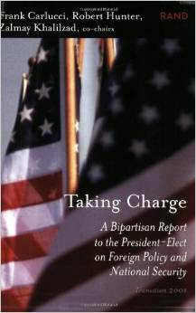
IV. Engagement and Expansion
The goal of the United States global strategy is to maintain American leadership in the world, and not allow any world power or regional power to emerge to challenge American global leadership.

Slide 22
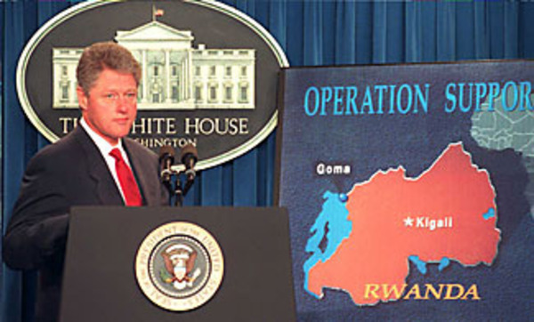
IV. Engagement and Expansion
The Clinton Administration made national security, economic prosperity and promotion of democracy the three pillars of American foreign policy.

Slide 23
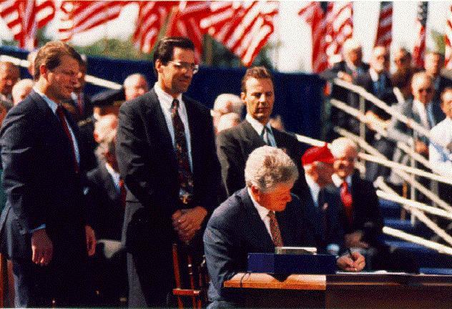
IV. Engagement and Expansion
Engagement and expansion, as its national strategy, means the United States will take a more active part in world affairs and will more actively promote market economy and American style democracy

Slide 24
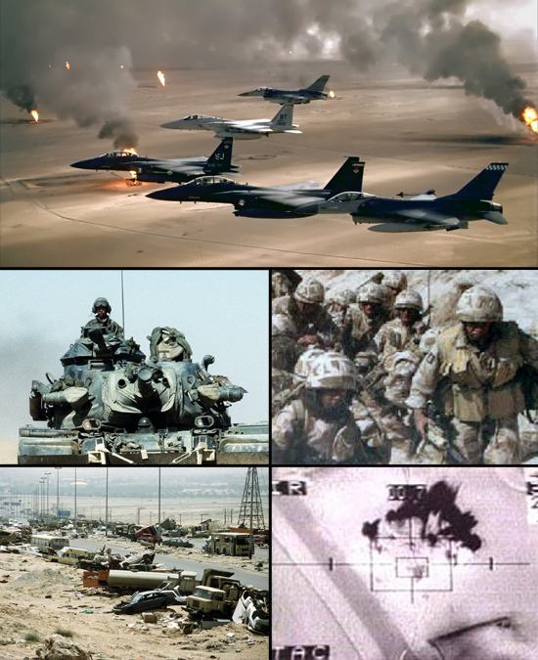
IV. Engagement and Expansion
Wars that made the United States the only supper power of the world:
the first Gulf War against Saddam Hussein of Iraq in 1991
the 44-day air war against the former Yugoslavia in 1999

Slide 25
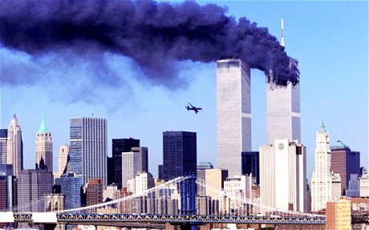
V. American Foreign Policy after 9/11
On September11, 2001, terrorists hijacked American passenger planes, and launched two suicidal attacks on New York City and Washington D.C.

Slide 26
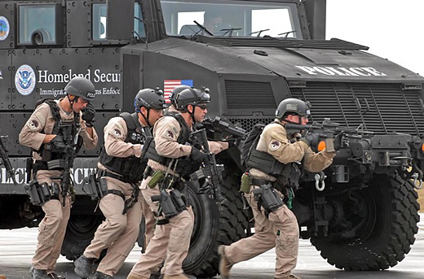
V. American Foreign Policy after 9/11
The Bush Administration responded to the attack by waging a war on terrorism through a coalition of the willing.

Slide 27
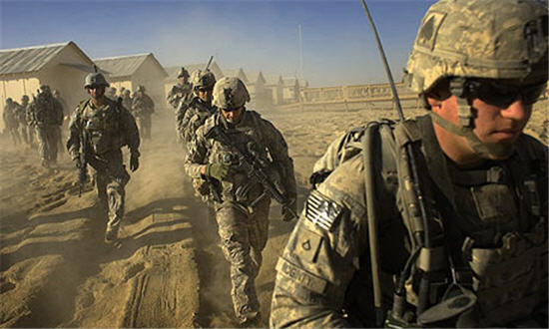
V. American Foreign Policy after 9. 11
In October 2001, the United States launched an all round attack on Afghanistan and won a decisive victory in two months’ time.

Slide 28
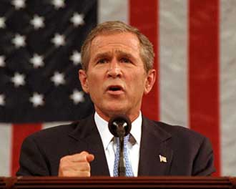
V. American Foreign Policy after 9. 11
In the State of the Union Message of 2002, President Bush surprised the world by naming Iraq, Iran and North Korea as Axis of Evil.

Slide 29
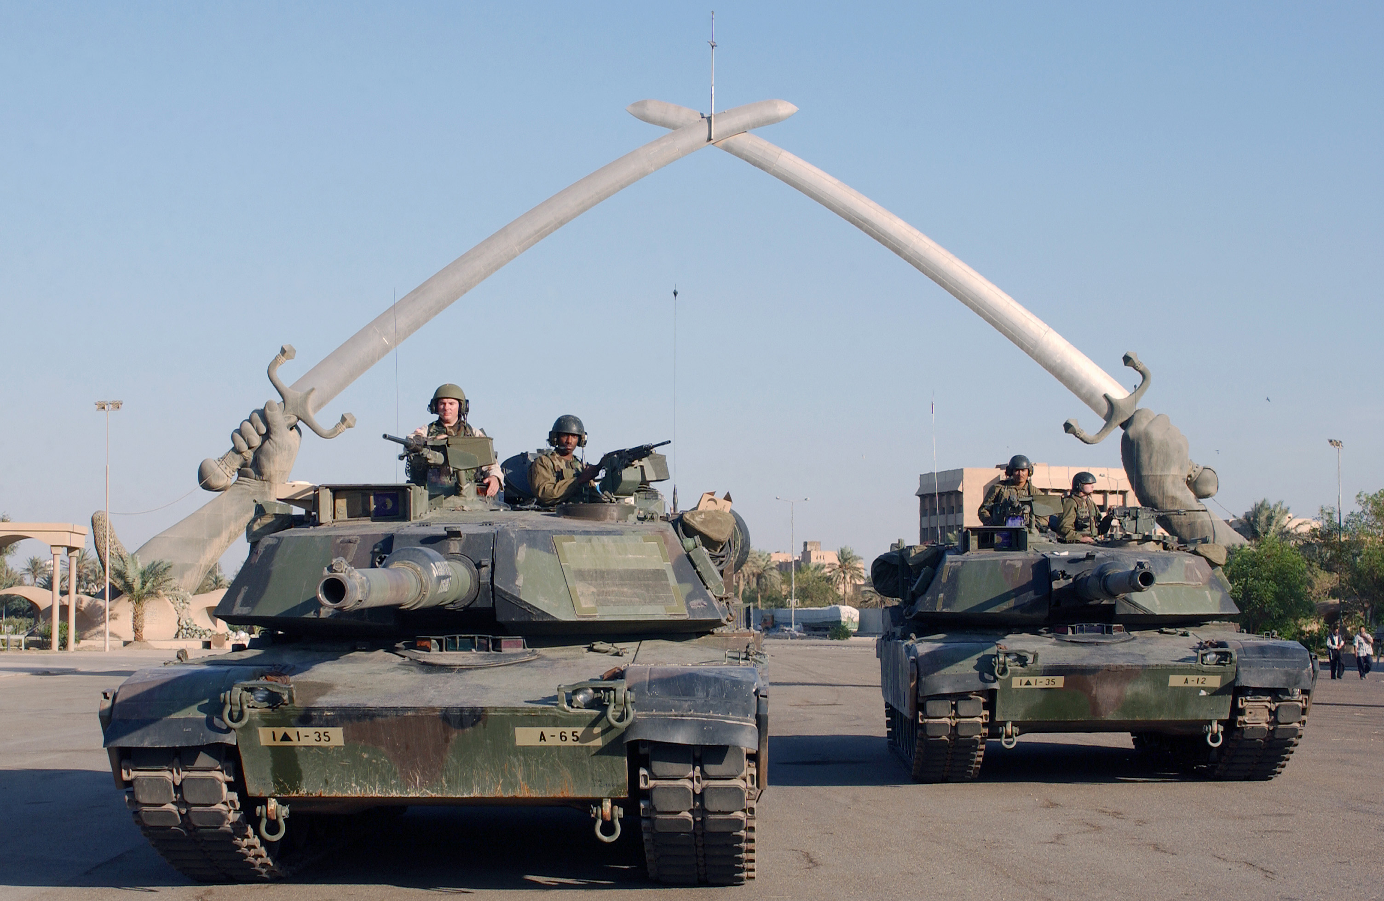
V. American Foreign Policy after 9/11
The Bush Doctrine, initiated in his speech known as the strategy of preemption at the West Point, by which the U.S. launched the 2nd Iraqi War.

Slide 30
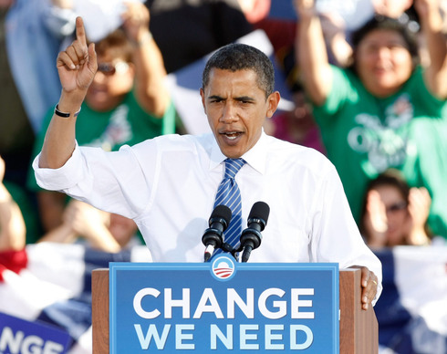
V. American Foreign Policy after 9/11
Barack Obama was elected to the White House in 2008. His goals of foreign policy were to re-establish America’s standing in the world; to create dialogue with friends, partners and adversaries based on mutual respect; and to work together in building partnership.

Slide 31
V. American Foreign Policy after 9/11
Obama went to Europe to attend three summit meetings—the London G20 Financial Summit, the NATO Summit, the London G20 Financial Summit;
He met with Chinese President Hu Jintao at London, and agreed to work together to build a positive, cooperative and comprehensive U.S.-China relationship for the 21st century.
In July 2009, Obama visited Moscow and agreed with Russian President Medvedev to start negotiations on a new START agreement.
Towards Iraq, Obama announced that “by August 31, 2010, our combat mission in Iraq will end.” But, in Afghanistan, he decided to send an additional 30,000 troops.

Slide 32
Conclusion
American foreign policy since WWII can be divided into two phases: the first between 1945 and 1991 and the second after 1991.
In the first phase, the basic goal of the foreign policy of the United States was to contain the Soviet Union.
In the second phase, the basic goal is to maintain American domination in the world as long as possible and to remake the world in American image.

Slide 33
Questions for Discussion
A. How did the Cold War begin? What role did the U.S. play in this?
B. What is the US containment policy? Is it successful? Illustrate your point with facts.
C. What new strategy did the U.S. develop in response to great changes in the world since the late 1980s?
D. How did the world respond to the Sept. 11 terrorist attack? What is the Bush Doctrine?
E. How do you evaluate the foreign policy pursued by the Obama Administration?

Slide 34
The End
高等教育出版社
2015

